Slide 1
Recent breakthroughs in mathematical and computational phylogenetics
Tandy Warnow
Departments of Computer Science and Bioengineering
The University of Illinois at Urbana-Champaign
http://tandy.cs.illinois.edu

Slide 2
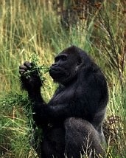
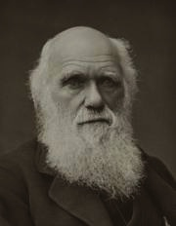


Phylogeny (evolutionary tree)
Gorilla
Human
Chimpanzee
Orangutan
From the Tree of the Life Website, University of Arizona

Slide 3
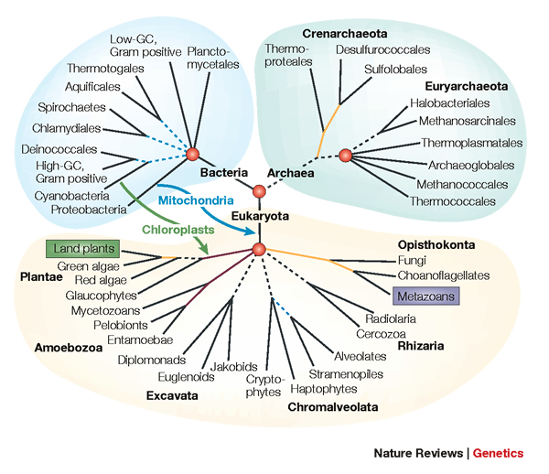
Applications of Phylogenies
“Nothing in biology makes sense except in the light of evolution” - Dobzhansky
Biological Research:
What did the earliest organisms look like?
Protein structure and function
Population genetics
Human migrations
What bacteria are in your gut, and what are they doing?

Slide 4
Hard Computational Problems
NP-hard problems
Large datasets
100,000+ sequences
thousands of genes
“Big data” complexity:
model misspecification
fragmentary sequences
errors in input data
streaming data
CS/Statistics Research: Discrete algorithms, graph-theory, probability theory, statistical
inference, parallel computing, data mining, machine learning, massive simulations, etc.

Slide 5


My Research:
Grand Computational Challenges in
Computational Phylogenetics and Metagenomics*
Courtesy of the Tree of Life project
*Plus historical linguistics (collaboration with linguist Donald Ringe at Penn)

Slide 6
Multiple Sequence Alignment (MSA): another grand challenge¹
S1 = AGGCTATCACCTGACCTCCA
S2 = TAGCTATCACGACCGC
S3 = TAGCTGACCGC
…
Sn = TCACGACCGACA
S1 = -AGGCTATCACCTGACCTCCA
S2 = TAG-CTATCAC--GACCGC--
S3 = TAG-CT-------GACCGC--
…
Sn = -------TCAC--GACCGACA
Novel techniques needed for scalability and accuracy
NP-hard problems and large datasets
Current methods do not provide good accuracy
Few methods can analyze even moderately large datasets
Many important applications besides phylogenetic estimation
¹ Frontiers in Massive Data Analysis, National Academies Press, 2013

Slide 7
DNA Sequence Evolution
AAGACTT
-3 mil yrs
AAGACTT
-2 mil yrs
AAGGCCT
AAGGCCT
AAGGCCT
AAGGCCT
TGGACTT
TGGACTT
TGGACTT
TGGACTT
-1 mil yrs
AGGGCAT
AGGGCAT
AGGGCAT
TAGCCCT
TAGCCCT
TAGCCCT
AGCACTT
AGCACTT
AGCACTT
AGGGCAT
TAGCCCA
TAGACTT
AGCACAA
AGCGCTT
today
AGGGCAT
TAGCCCA
TAGACTT
AGCACAA
AGCGCTT

Slide 8
Phylogeny Problem
U
V
W
X
Y
AGGGCAT
TAGCCCA
TAGACTT
TGCACAA
TGCGCTT
X
U
Y
V
W

Slide 9
The “real” problem
U
V
W
X
Y
AGGGCATGA
AGAT
TAGACTT
TGCACAA
TGCGCTT
X
U
Y
V
W

Slide 10
Indels (insertions and deletions)
Deletion
Mutation
…ACGGTGCAGTTACCA…
…ACCAGTCACCA…
Notes:
10

Slide 11
Deletion
Substitution
…ACGGTGCAGTTACCA…
Insertion
…ACGGTGCAGTTACC-A…
…AC----CAGTCACCTA…
…ACCAGTCACCTA…
The true multiple alignment
  Reflects historical substitution, insertion, and deletion events
  Defined using transitive closure of pairwise alignments computed on edges of the true tree
Notes:
11
Homology = nucleotides lined up since they come from a common ancestor.
Indel = dash.

Slide 12
Input: unaligned sequences
S1 = AGGCTATCACCTGACCTCCA
S2 = TAGCTATCACGACCGC
S3 = TAGCTGACCGC
S4 = TCACGACCGACA

Slide 13
Phase 1: Alignment
S1 = AGGCTATCACCTGACCTCCA
S2 = TAGCTATCACGACCGC
S3 = TAGCTGACCGC
S4 = TCACGACCGACA
S1 = -AGGCTATCACCTGACCTCCA
S2 = TAG-CTATCAC--GACCGC--
S3 = TAG-CT-------GACCGC--
S4 = -------TCAC--GACCGACA

Slide 14
Phase 2: Construct tree
S1 = AGGCTATCACCTGACCTCCA
S2 = TAGCTATCACGACCGC
S3 = TAGCTGACCGC
S4 = TCACGACCGACA
S1 = -AGGCTATCACCTGACCTCCA
S2 = TAG-CTATCAC--GACCGC--
S3 = TAG-CT-------GACCGC--
S4 = -------TCAC--GACCGACA
S1
S2
S4
S3

Slide 15
Phylogenomic pipeline
Select taxon set and markers
Gather and screen sequence data, possibly identify orthologs
Compute multiple sequence alignments for each locus
Compute species tree or network:
  Compute gene trees on the alignments and combine the estimated gene trees, OR
  Estimate a tree from a concatenation of the multiple sequence alignments
Get statistical support on each branch (e.g., bootstrapping)
Estimate dates on the nodes of the phylogeny
Use species tree with branch support and dates to understand biology

Slide 16
Phylogenomic pipeline
Select taxon set and markers
Gather and screen sequence data, possibly identify orthologs
Compute multiple sequence alignments for each locus
Compute species tree or network:
  Compute gene trees on the alignments and combine the estimated gene trees, OR
  Estimate a tree from a concatenation of the multiple sequence alignments
Get statistical support on each branch (e.g., bootstrapping)
Estimate dates on the nodes of the phylogeny
Use species tree with branch support and dates to understand biology

Slide 17
Large-scale Alignment Estimation
Many genes are considered unalignable due to high rates of evolution
Only a few methods can analyze large datasets
iPlant (NSF Plant Biology Collaborative) and other projects planning to construct phylogenies with 500,000 taxa

Slide 18

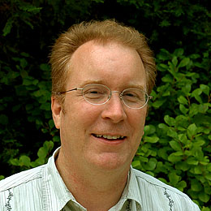






1kp: Thousand Transcriptome Project
G. Ka-Shu Wong
U Alberta
J. Leebens-Mack
U Georgia
N. Wickett
Northwestern
N. Matasci
iPlant
T. Warnow, S. Mirarab, N. Nguyen, Md. S.Bayzid
UIUC UT-Austin UT-Austin UT-Austin
Plus many many other people…
First study (Wickett, Mirarab, et al., PNAS 2014) had ~100 species and ~800 genes, gene trees and alignments estimated using SATe, and a coalescent-based species tree estimated using ASTRAL
Second study: Plant Tree of Life based on transcriptomes of ~1200 species, and more than 13,000 gene families (most not single copy)
Gene Tree Incongruence
Upcoming Challenges:
Species tree estimation from conflicting gene trees
Alignment of datasets with > 100,000 sequences

Slide 19
This talk
“Big data” multiple sequence alignment
SATé (Science 2009, Systematic Biology 2012) and PASTA (RECOMB and JCB 2014), methods for co-estimation of alignments and trees
The UPP method (ultra-large multiple sequence alignments using phylogenetic profiles), and its HMM Ensemble technique (submitted)

Slide 20
Multiple Sequence Alignment

Slide 21
First Align, then Compute the Tree
S1 = AGGCTATCACCTGACCTCCA
S2 = TAGCTATCACGACCGC
S3 = TAGCTGACCGC
S4 = TCACGACCGACA
S1 = -AGGCTATCACCTGACCTCCA
S2 = TAG-CTATCAC--GACCGC--
S3 = TAG-CT-------GACCGC--
S4 = -------TCAC--GACCGACA
S1
S2
S4
S3

Slide 22
Simulation Studies
S1 = AGGCTATCACCTGACCTCCA
S2 = TAGCTATCACGACCGC
S3 = TAGCTGACCGC
S4 = TCACGACCGACA
Unaligned Sequences
S1 = -AGGCTATCACCTGACCTCCA
S2 = TAG-CTATCAC--GACCGC--
S3 = TAG-CT-------GACCGC--
S4 = -------TCAC--GACCGACA
S1 = -AGGCTATCACCTGACCTCCA
S2 = TAG-CTATCAC--GACCGC--
S3 = TAG-C--T-----GACCGC--
S4 = T---C-A-CGACCGA----CA
S1
S2
S1
S4
Compare
S4
S3
S2
S3
True tree and alignment
Estimated tree and alignment

Slide 23
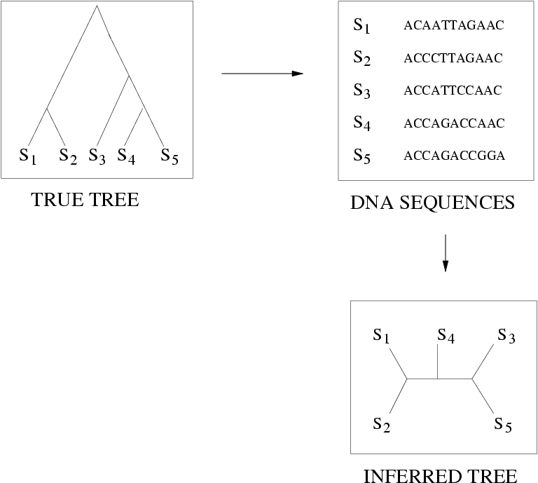
Quantifying Error
FN
FN: false negative
(missing edge)
FP: false positive
(incorrect edge)
50% error rate
FP

Slide 24
Two-phase estimation
Alignment methods
Clustal
POY (and POY*)
Probcons (and Probtree)
Probalign
MAFFT
Muscle
Di-align
T-Coffee
Prank (PNAS 2005, Science 2008)
Opal (ISMB and Bioinf. 2007)
FSA (PLoS Comp. Bio. 2009)
Infernal (Bioinf. 2009)
Etc.
Phylogeny methods
Bayesian MCMC
Maximum parsimony
Maximum likelihood
Neighbor joining
FastME
UPGMA
Quartet puzzling
Etc.
RAxML: heuristic for large-scale ML optimization
Notes:
24

Slide 25
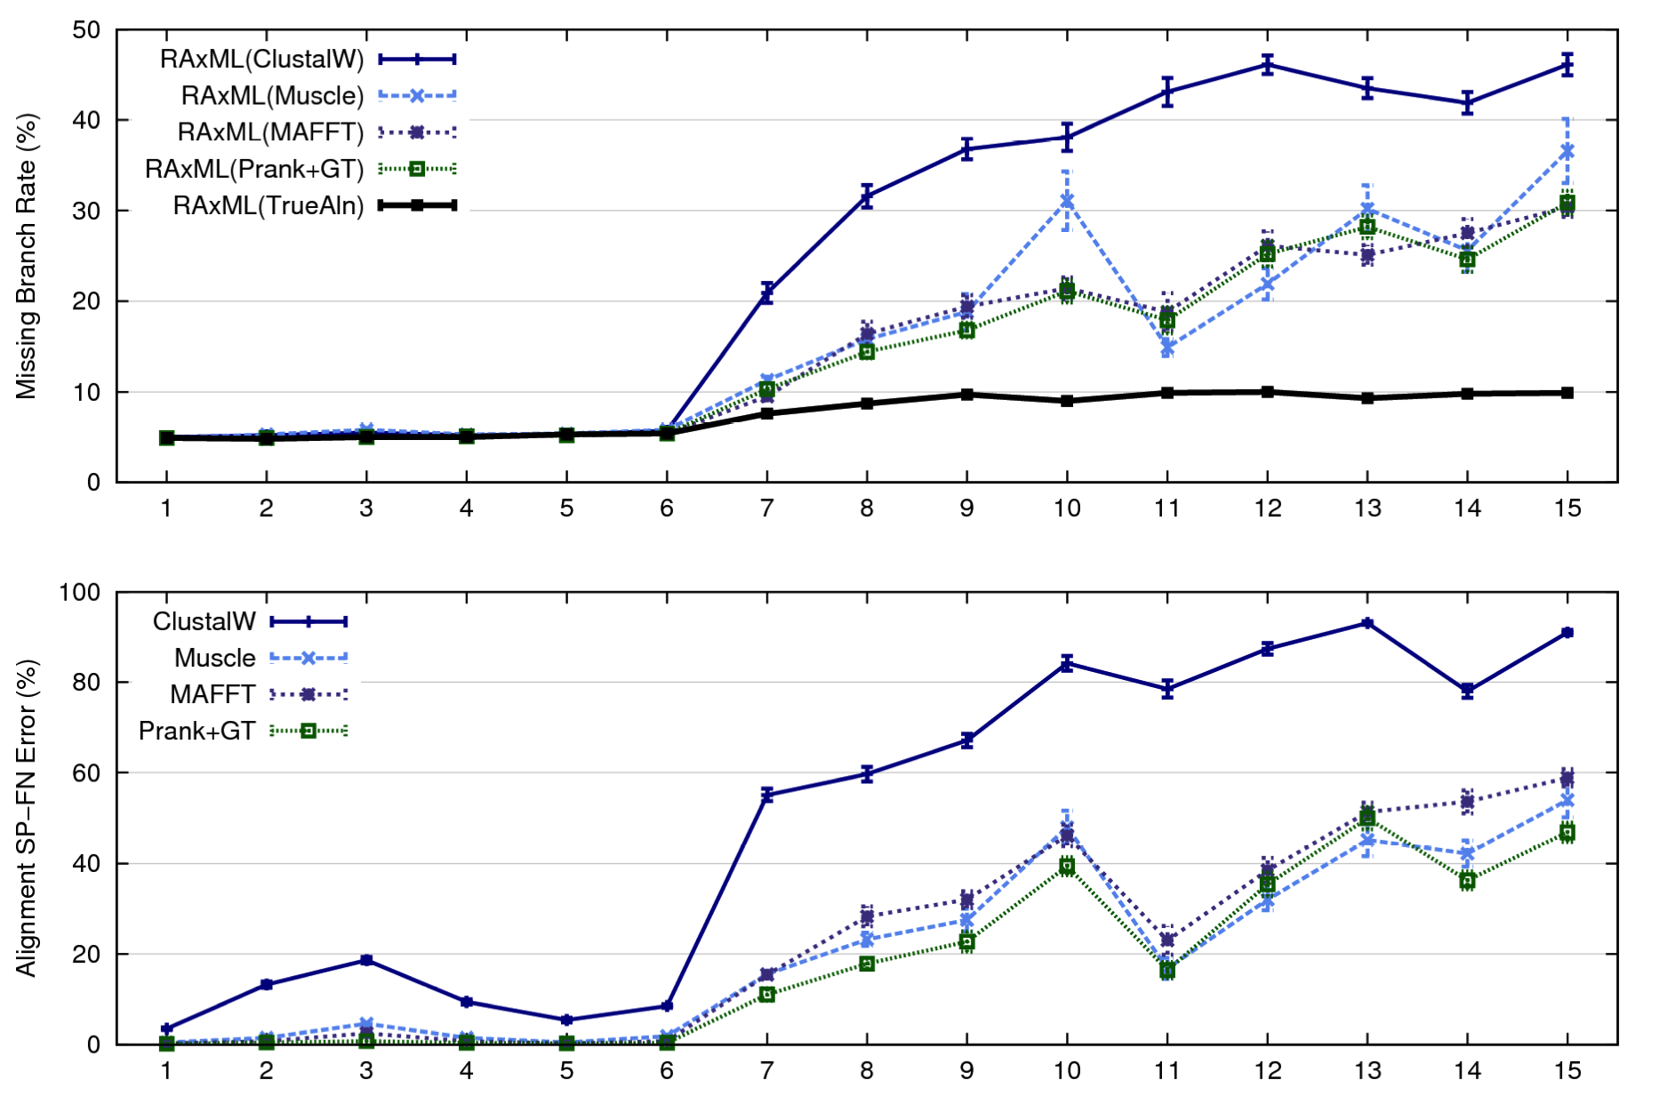
1000-taxon models, ordered by difficulty (Liu et al., 2009)
Notes:
25
1. 2 classes of MC: easy, moderate-to-difficult
2. true alignment
3. 2 classes: ClustalW, everything else
Alignment error, measured this way, isn't a perfect predictor of tree error, measured this way.

Slide 26
Re-aligning on a tree
A
C
Decompose dataset
A
B
C
D
B
D
Align subproblems
A
B
C
D
Estimate ML tree on merged alignment
ABCD
Merge
sub-alignments

Slide 27
SATé and PASTA Algorithms
Obtain initial alignment and estimated ML tree
Tree
Use tree to compute new alignment
Estimate ML tree on new alignment
Alignment
If new alignment/tree pair has worse ML score, realign using a different decomposition
Repeat until termination condition (typically, 24 hours)

Slide 28
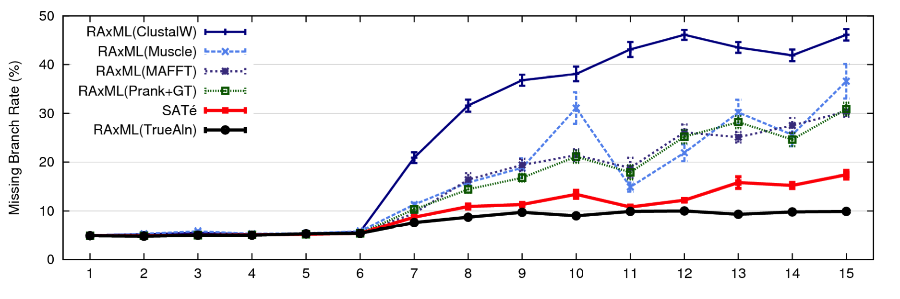
SATé-1 (Science 2009) performance
1000 taxon models, ordered by difficulty
SATé-1 24 hour analysis, on desktop machines
(Similar improvements for biological datasets)
SATé-1 can analyze up to about 30,000 sequences.
Notes:
For moderate-to-difficult datasets, SATe gets better trees and alignments than all other estimated methods. Close to what you might get if you had access to true alignment.
Opens up a new realm of possibility: Datasets currently considered “unalignable” can in fact be aligned reasonably well. This opens up the feasibility of accurate estimations of deep evolutionary histories using a wider range of markers.
TRANSITION: can we do better? What about smaller simulated datasets? And what about biological datasets?

Slide 29
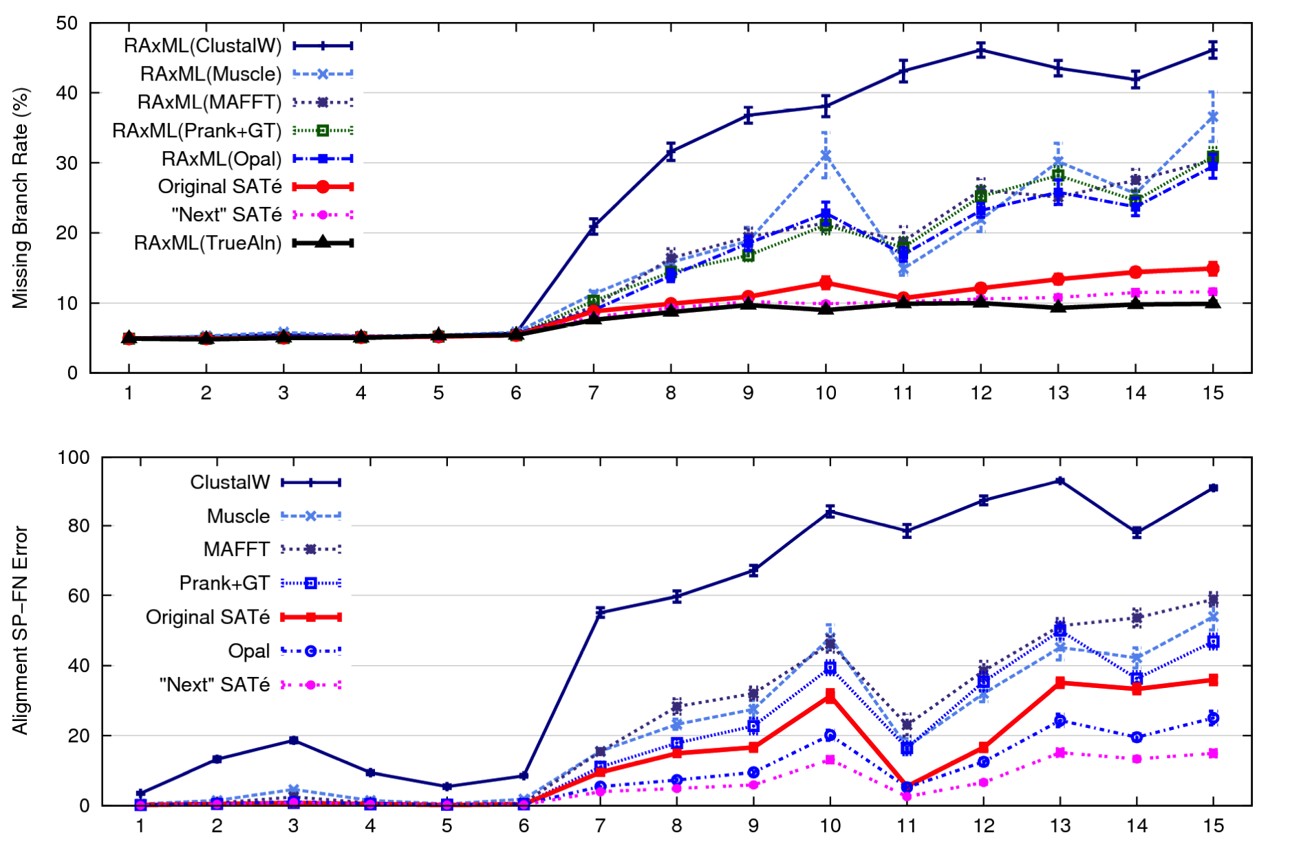
SATé-1 and SATé-2 (Systematic Biology, 2012)
1000 taxon models ranked by difficulty

Slide 30
PASTA (2014): even better than SATé-2
PASTA vs. SATé-2
Faster,
Can analyze larger
datasets (up to
1,000,000 sequences –
SATé-2 can analyze
50,000 sequences)
(c) More accurate!

Slide 31
1kp: Thousand Transcriptome Project
G. Ka-Shu Wong
U Alberta
J. Leebens-Mack
U Georgia
N. Wickett
Northwestern
N. Matasci
iPlant
T. Warnow, S. Mirarab, N. Nguyen, Md. S.Bayzid
UIUC UT-Austin UT-Austin UT-Austin
Plus many many other people…
Plant Tree of Life based on transcriptomes of ~1200 species
More than 13,000 gene families (most not single copy)
Gene Tree Incongruence
Challenge:
Alignment of datasets with > 100,000 sequences

Slide 32
1KP dataset: more than
100,000 p450 amino-acid
sequences, many fragmentary

Slide 33
1KP dataset: more than
100,000 p450 amino-acid
sequences, many fragmentary
All standard multiple
sequence alignment
methods we tested
performed poorly on
datasets with fragments.

Slide 34
1kp: Thousand Transcriptome Project
G. Ka-Shu Wong
U Alberta
J. Leebens-Mack
U Georgia
N. Wickett
Northwestern
N. Matasci
iPlant
T. Warnow, S. Mirarab, N. Nguyen, Md. S.Bayzid
UIUC UT-Austin UT-Austin UT-Austin
Plus many many other people…
Plant Tree of Life based on transcriptomes of ~1200 species
More than 13,000 gene families (most not single copy)
Gene Tree Incongruence
Challenge:
Alignment of datasets with > 100,000 sequences
with many fragmentary sequences

Slide 35
UPP: large-scale MSA estimation
UPP = “Ultra-large multiple sequence alignment using Phylogeny-aware Profiles”
Nguyen, Mirarab, and Warnow. Under review.
Objective: highly accurate large-scale multiple sequence alignments, even in the presence of fragmentary sequences.

Slide 36
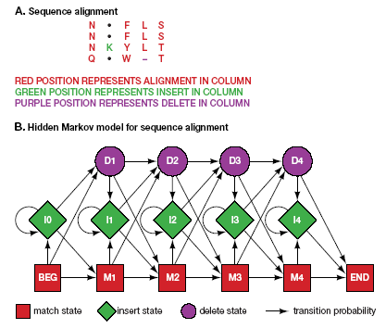
Profile HMMs

Slide 37
A simple idea
Select random subset of sequences, and build “backbone alignment”
Construct a profile Hidden Markov Model (HMM) to represent the backbone alignment
Add all remaining sequences to the backbone alignment using the HMM
Fast!
But is it accurate?

Slide 38
A simple idea
Select random subset of sequences, and build “backbone alignment”
Construct a profile Hidden Markov Model (HMM) to represent the backbone alignment
Add all remaining sequences to the backbone alignment using the HMM
Fast!
But is it accurate?

Slide 39
Simple technique:
1) build one HMM for the entire alignment
2) Align fragment to the HMM, and insert into alignment

Slide 40
One Hidden Markov Model for the entire alignment?

Slide 41
Or 2 HMMs?

Slide 42
Or 4 HMMs?

Slide 43
Or 7 HMMs?

Slide 44
UPP Algorithmic Approach
Select random subset of sequences, and build “backbone alignment”
Construct an “Ensemble of Hidden Markov Models” on the backbone alignment (the family has HMMs on overlapping subsets of different sizes)
Add all remaining sequences to the backbone alignment using the Ensemble of HMMs

Slide 45
Evaluation
Simulated datasets (some have fragmentary sequences):
  10K to 1,000,000 sequences in RNASim (Guo, Wang, and Kim, arxiv)
  1000-sequence nucleotide datasets from SATé papers
  5000-sequence AA datasets (from FastTree paper)
  10,000-sequence Indelible nucleotide simulation
Biological datasets:
  Proteins: largest BaliBASE and HomFam
  RNA: 3 CRW datasets up to 28,000 sequences

Slide 46
Impact of backbone size and use of HMM Ensemble technique
Notes:
Relative performance
under standard alignment
criteria is not predictive
of relative performance
for tree estimation.
For alignment estimation,
a large backbone is important.
For tree estimation,
the use of the HMM Ensemble
is most important, but large
backbones also help.

Slide 47
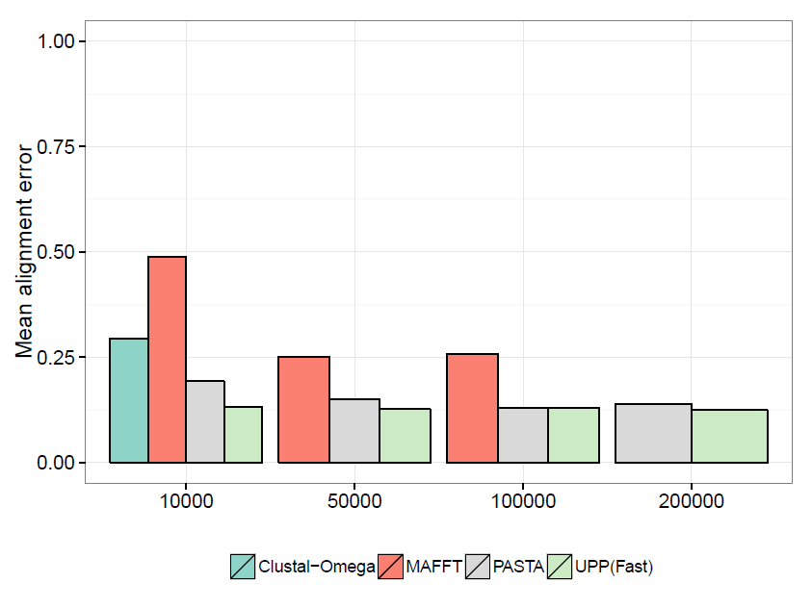
RNASim: alignment error
All methods given 24 hrs on a 12-core machine
Note: Mafft was run under default settings for 10K and 50K sequences
and under Parttree for 100K sequences, and fails to complete under any setting
For 200K sequences. Clustal-Omega only completes on 10K dataset.

Slide 48
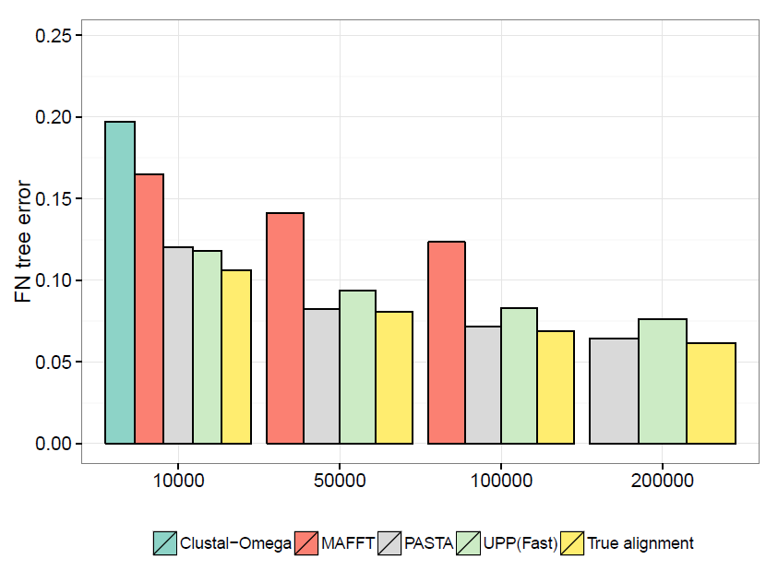
RNASim: tree error
All methods given 24 hrs on a 12-core machine
Note: Mafft was run under default settings for 10K and 50K sequences
and under Parttree for 100K sequences, and fails to complete under any setting
For 200K sequences. Clustal-Omega only completes on 10K dataset.

Slide 49
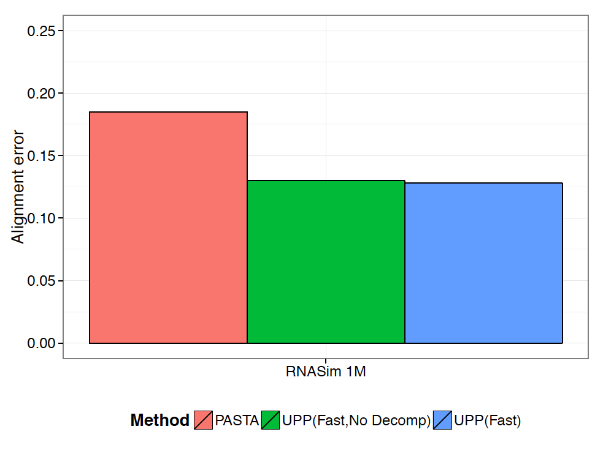
RNASim Million Sequences: alignment error
Notes:
We show alignment error using average of SP-FN and SP-FP. UPP variants have better scores than PASTA.
But for the Total Column (TC) scores, PASTA is better than UPP: it recovered 10% of the columns compared to less than 0.04% for UPP variants.
PASTA under-aligns: its alignment is 43 times wider than true alignment (~900 Gb of disk space). UPP alignments were closer in length to true alignment (0.93 to 1.38 wider).

Slide 50
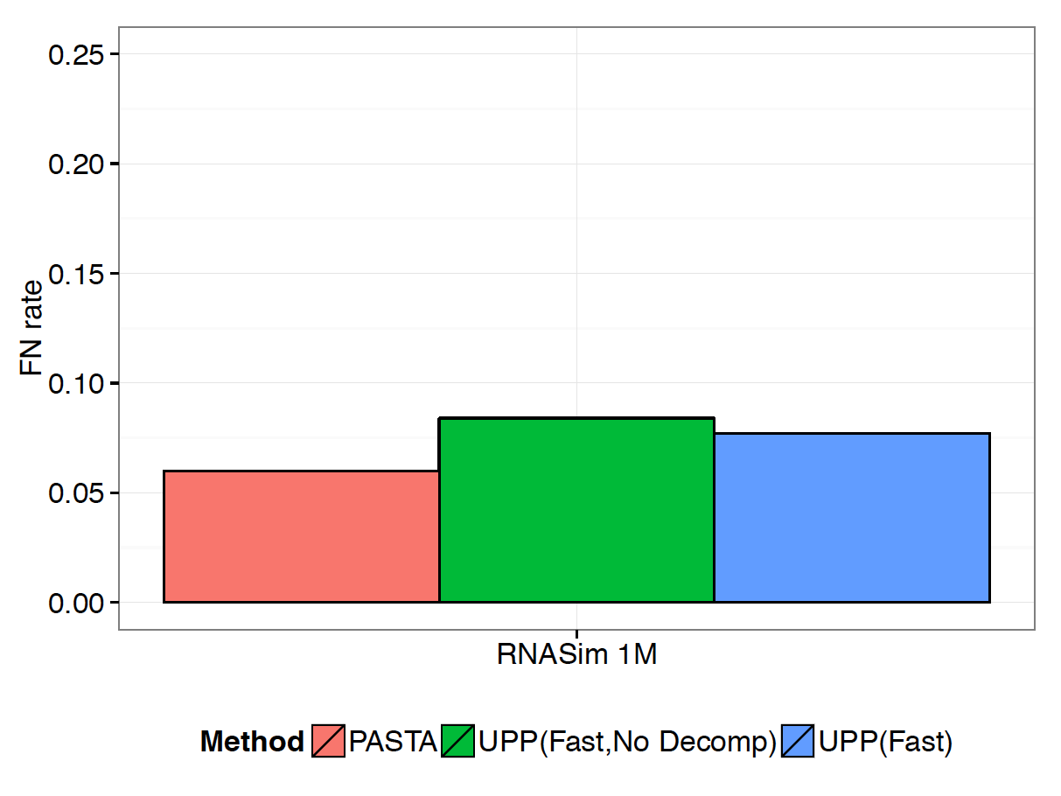
RNASim Million Sequences: tree error
Notes:
UPP(Fast,NoDecomp) took 2.2 days,
UPP(Fast) took 11.9 days, and
PASTA took 10.3 days (all using 12 processors).

Slide 51
UPP vs. PASTA: impact of fragmentation
Under high rates of evolution,
PASTA is badly impacted
by fragmentary sequences (the
same is true for other methods).
Under low rates of evolution,
PASTA can still be highly accurate
(data not shown).
UPP continues to have good
accuracy even on datasets
with many fragments under
all rates of evolution.
Performance on fragmentary datasets of the 1000M2 model condition

Slide 52
Running Time
Wall-clock time used (in hours) given 12 processors

Slide 53
Summary
SATé-1 (Science 2009), SATé-2 (Systematic Biology 2012), and PASTA (RECOMB 2014): methods for co-estimating gene trees and multiple sequence alignments.
PASTA can analyze up to 1,000,000 sequences, and is highly accurate for full-length sequences. But none of these methods are robust to fragmentary sequences.
HMM Ensemble technique: uses a collection of HMMs to represent a “backbone alignment”. HMM ensembles improve accuracy, especially in the presence of high rates of evolution.
Applications of HMM Ensembles in:
  UPP (ultra-large multiple sequence alignment), under review
  SEPP (phylogenetic placement), PSB 2012 (not shown)
  TIPP (metagenomic taxon identification and abundance profiling), Bioinformatics 2014 (not shown)

Slide 54
The Tree of Life: Multiple Challenges
Scientific challenges:
Ultra-large multiple-sequence alignment
Alignment-free phylogeny estimation
Supertree estimation
Estimating species trees from many gene trees
Genome rearrangement phylogeny
Reticulate evolution
Visualization of large trees and alignments
Data mining techniques to explore multiple optima
Theoretical guarantees under Markov models of evolution
Techniques:
machine learning, applied probability theory, graph theory, combinatorial optimization,
supercomputing, and heuristics

Slide 55

Acknowledgments
PhD students: Nam Nguyen* and Siavash Mirarab**
Undergrad: Keerthana Kumar
Lab Website: http://www.cs.utexas.edu/users/phylo
Personal Website: http://tandy.cs.illinois.edu
Write to me: warnow@illinois.edu (I am recruiting students!)
Funding: Guggenheim Foundation, NSF, Microsoft Research New England, David Bruton Jr. Centennial Professorship, TACC (Texas Advanced Computing Center), and the University of Alberta (Canada)
TACC and UTCS computational resources
* Now a postdoc with Becky Stumpf and Bryan White (ICB, UIUC)
** Supported by HHMI Predoctoral Fellowship

Slide 56



CS @ ILLINOIS
Siebel Center for Computer Science
Siebel Center for Computer Science
…given by CS alum Tom Siebel (Siebel Sys., C3)

Slide 57

It’s a Top 5 National Ranking Program

Slide 58












Many Entrepreneurial Success Stories from CS
Founded by
CS alum(s)
Led (now or earlier) by
CS alum(s)

Slide 59



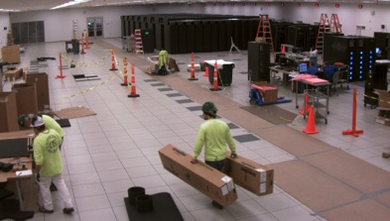
Parallel Computing in CS: Blue Waters
1
US Track-1 High-Performance Computing system: 400,000 x86 cores, one of largest machines on planet…
at The University of Illinois!

Slide 60

Tuition and Assistantships
The majority of M.S. and Ph.D. graduate students hold either a
  Fellowship
  Teaching Assistantship, or
  Research Assistantship
For more information on the University of Illinois graduate tuition and fees, visit: http://registrar.illinois.edu/financial/tuition_1415/AY/grad.html

Slide 61

For More Information
Call (217) 333-4428
Email academic@cs.illinois.edu
Visit http://cs.illinois.edu/prospective-students/graduate-students
Tandy’s email: warnow@illinois.edu, and
Tandy’s webpage: http://tandy.cs.illinois.edu

Slide 62
CS @ Illinois
Graduate Programs

Slide 63
It’s a Top 5 National Ranking Program

Slide 64

And Many Research Area Disciplines
Theory
& Algorithms
Architecture, Compilers & Parallel Computing
Computer
Science
Artificial Intelligence
Scientific Computing
Bioinformatics & Computational Biology
Systems & Networking
Programming Languages, Formal Methods & Software Engineering
Database & Information Systems
Graphics, Visualization & HCI

Slide 65
Many Entrepreneurial Success Stories from CS
Founded by
CS alum(s)
Led (now or earlier) by
CS alum(s)

Slide 66
Choose a Program…
Ph.D.
MS (thesis)
Computer
Science
MS Bioinformatics
I2CS MCS
(professional master’s online)
MCS
(non-thesis, professional master’s on campus)
For more information, visit www.cs.illinois.edu/graduate/academics.

Slide 67
Tuition and Assistantships
The majority of M.S. and Ph.D. graduate students hold either a
  Fellowship
  Teaching Assistantship, or
  Research Assistantship
For more information on the University of Illinois graduate tuition and fees, visit: http://registrar.illinois.edu/financial/tuition_1415/AY/grad.html

Slide 68
For More Information
Call (217) 333-4428
Email academic@cs.illinois.edu
Visit http://cs.illinois.edu/prospective-students/graduate-students
Thanks for your interest in CS @ ILLINOIS!

Slide 69
CS @ Illinois
Graduate Programs

Slide 70
It’s a Top 5 National Ranking Program

Slide 71
And Many Research Area Disciplines
Theory
& Algorithms
Architecture, Compilers & Parallel Computing
Computer
Science
Artificial Intelligence
Scientific Computing
Bioinformatics & Computational Biology
Systems & Networking
Programming Languages, Formal Methods & Software Engineering
Database & Information Systems
Graphics, Visualization & HCI

Slide 72
Many Entrepreneurial Success Stories from CS
Founded by
CS alum(s)
Led (now or earlier) by
CS alum(s)

Slide 73
Tuition and Assistantships
The majority of M.S. and Ph.D. graduate students hold either a
  Fellowship
  Teaching Assistantship, or
  Research Assistantship
For more information on the University of Illinois graduate tuition and fees, visit: http://registrar.illinois.edu/financial/tuition_1415/AY/grad.html

Slide 74
For More Information
Call (217) 333-4428
Email academic@cs.illinois.edu
Visit http://cs.illinois.edu/prospective-students/graduate-students
Thanks for your interest in CS @ ILLINOIS!

Slide 76
Research Projects for PhD students
Multiple sequence alignment (e.g., consider duplications and rearrangements)
Species tree estimation when genes have conflicting evolutionary histories (very common!)
Phylogenetic networks (for horizontal gene transfer or hybridizing speciation)
Metagenomic taxon identification and applications in medicine
High performance computing for ultra-large datasets
Historical linguistics (how did Indo-European evolve?)
Contact me by email, warnow@illinois.edu http://tandy.cs.illinois.edu

Slide 77
RNASim Million Sequences: tree error
Using 12 processors:
UPP(Fast,NoDecomp) took 2.2 days.
UPP(Fast) took 11.9 days.

Slide 78
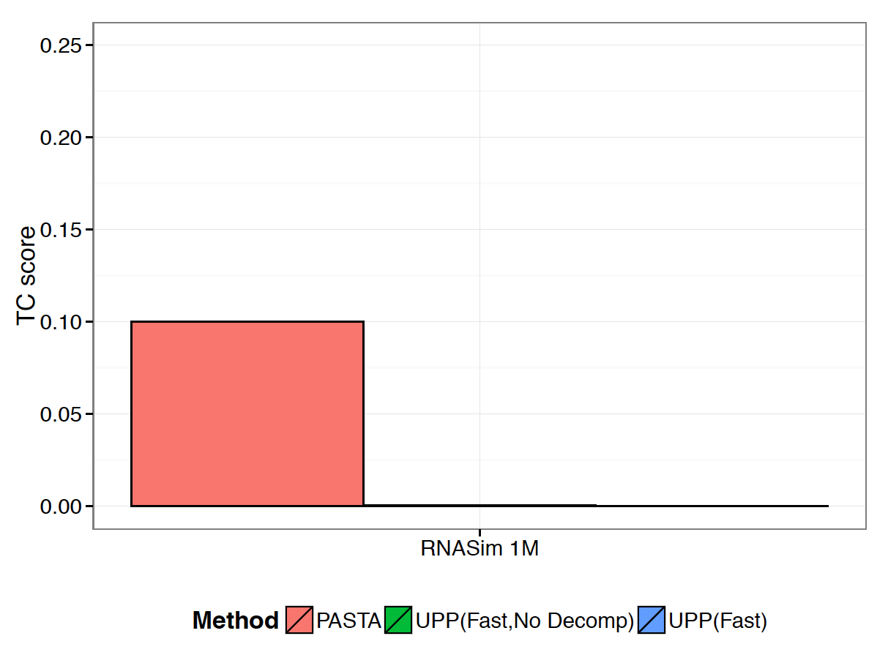
RNASim Million Sequences: TC score
Notes:
UPP(Fast,NoDecomp) took 2.2 days,
UPP(Fast) took 11.9 days, and
PASTA took 10.3 days (all using 12 processors).

Slide 79
Impact of backbone size and use of HMM Family technique
Notes:
Relative performance
under standard alignment
criteria is not predictive
of relative performance
for tree estimation.
For alignment estimation,
a large backbone is important.
For tree estimation,
the use of the HMM Family
is most important, but large
backbones also help.

Slide 80
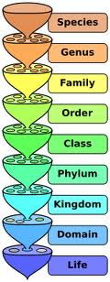
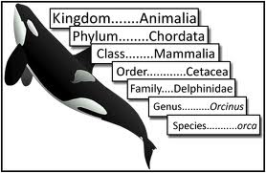
Metagenomic Taxon Identification
Objective: classify short reads in a metagenomic sample
Notes:
The two basic steps in phylogenetic placement is similar to the two phase methods we typically use, align and then place the fragment.
The differences are we align each fragment independently into the backbone tree. We then take each extended alignment and place each fragment independently into the backbone tree.
Two methods to align the query sequences are HMMALIGN, which estimates a hidden markov model on backbone alignemnt, then aligns query sequence. PaPaRa, which estimates ancestoral parsimony state vectors for each each in the reference tree and aligns the query sequence against each state vector. It selects the best scoring alignment.
Two methods that place the query sequence try to optimize the same criterion: find the ML placement given the extended alignment

Slide 81
Basic Questions
1. What is this fragment? (Classify each fragment as well as possible.)
2. What is the taxonomic distribution in the dataset? (Note: helpful to use marker genes.)
3. What are the organisms in this metagenomic sample doing together?
Notes:
The two basic steps in phylogenetic placement is similar to the two phase methods we typically use, align and then place the fragment.
The differences are we align each fragment independently into the backbone tree. We then take each extended alignment and place each fragment independently into the backbone tree.
Two methods to align the query sequences are HMMALIGN, which estimates a hidden markov model on backbone alignemnt, then aligns query sequence. PaPaRa, which estimates ancestoral parsimony state vectors for each each in the reference tree and aligns the query sequence against each state vector. It selects the best scoring alignment.
Two methods that place the query sequence try to optimize the same criterion: find the ML placement given the extended alignment

Slide 82
Phylogenetic Placement
Fragmentary sequences
from some gene
Full-length sequences for same gene, and an alignment and a tree
ACCG
CGAG
CGG
GGCT
TAGA
GGGGG
TCGAG
GGCG
GGG
.
.
.
ACCT
AGG...GCAT
TAGC...CCA
TAGA...CTT
AGC...ACA
ACT..TAGA..A
Notes:
The two basic steps in phylogenetic placement is similar to the two phase methods we typically use, align and then place the fragment.
The differences are we align each fragment independently into the backbone tree. We then take each extended alignment and place each fragment independently into the backbone tree.
Two methods to align the query sequences are HMMALIGN, which estimates a hidden markov model profile for the backbone alignment, and then aligns the query sequence to the model, and PaPaRa, which estimates ancestoral parsimony state vectors for each each in the reference tree and aligns the query sequence against each state vector. It selects the best scoring alignment.
Two methods that place the query sequence try to optimize the same criterion: find the ML placement given the extended alignment

Slide 83
TIPP vs. other abundance profilers
TIPP is highly accurate, even in the presence of high indel rates and novel genomes, and for both short and long reads.
All other methods have some vulnerability (e.g., mOTU is only accurate for short reads and is impacted by high indel rates).

Slide 84
Phylogenetic “boosters”
Goal: improve accuracy, speed, robustness, or theoretical guarantees of base methods
Techniques: divide-and-conquer, iteration, chordal graph algorithms, and “bin-and-conquer”
Examples:
DCM-boosting for distance-based methods (1999)
DCM-boosting for heuristics for NP-hard problems (1999)
SATé- and PASTA-boosting for alignment methods (2009, 2012, and 2014)
SuperFine-boosting for supertree methods (2012)
DACTAL: almost alignment-free phylogeny estimation methods (2012)
SEPP-boosting for phylogenetic placement of short sequences (2012)
TIPP-boosting for metagenomic taxon identification (submitted)
UPP-boosting for alignment methods (in preparation)
Bin-and-conquer for coalescent-based species tree estimation (2013 and 2014)

Slide 85
Algorithmic Strategies
Divide-and-conquer
Chordal graph decompositions
Iteration
Multiple HMMs
Bin-and-conquer (technique used for improving species tree estimation from multiple gene trees, Bayzid and Warnow, Bioinformatics 2013)

Slide 86





1kp: 1000 Plant Transcriptomes
G. Ka-Shu Wong
U Alberta
J. Leebens-Mack
U Georgia
N. Wickett
Northwestern
N. Matasci
iPlant
T. Warnow, S. Mirarab, N. Nguyen,
UT-Austin UT-Austin UT-Austin
Plus many many other people…
Whole Transcriptomes of 103 plant species and 850 single copy loci (1200 taxa in next phase)
  Most accurate summary methods cannot handle this size
Common ancestor about 1 billion years ago and so gene trees are hard to root
  Most summary methods need rooted gene trees
Pre-existing summary methods do not provide reasonable results on this dataset
[Wickett et al. (under review), 2014.]

Slide 87
Combined analysis
gene 1
gene 2
gene 3
S₁
TCTAATGGAA
? ? ? ? ? ? ? ? ? ?
TATTGATACA
S₂
GCTAAGGGAA
? ? ? ? ? ? ? ? ? ?
? ? ? ? ? ? ? ? ? ?
S₃
TCTAAGGGAA
TCTTGATACC
? ? ? ? ? ? ? ? ? ?
S₄
TCTAACGGAA
GGTAACCCTC
TAGTGATGCA
S₅
? ? ? ? ? ? ? ? ? ?
GCTAAACCTC
? ? ? ? ? ? ? ? ? ?
S₆
? ? ? ? ? ? ? ? ? ?
GGTGACCATC
? ? ? ? ? ? ? ? ? ?
S₇
TCTAATGGAC
GCTAAACCTC
TAGTGATGCA
S₈
TATAACGGAA
? ? ? ? ? ? ? ? ? ?
CATTCATACC

Slide 88
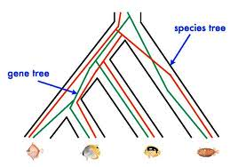
Red gene tree ≠ species tree
(green gene tree okay)

Slide 89
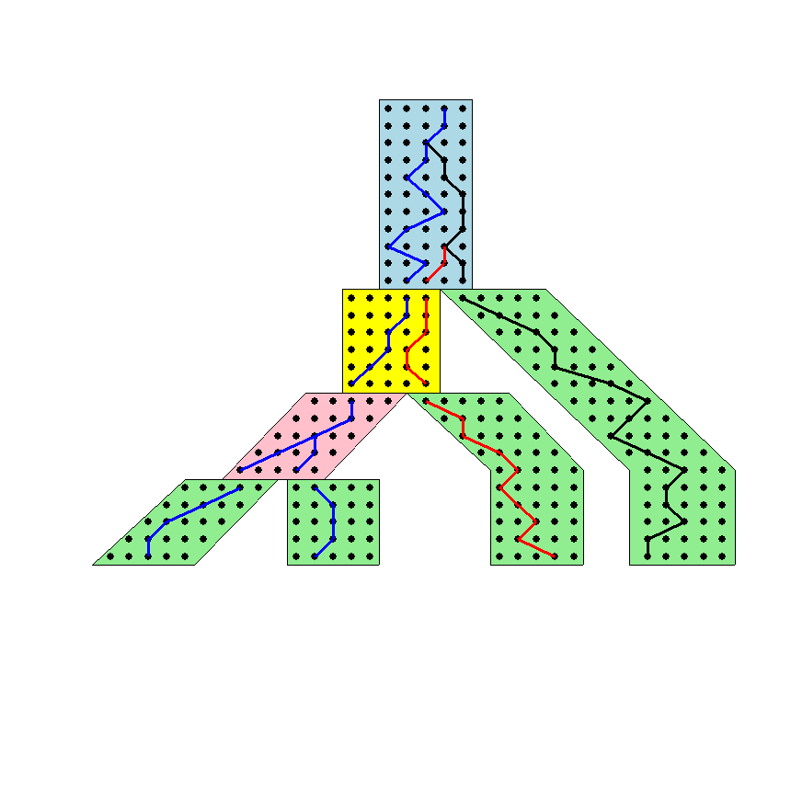




The Coalescent
Courtesy James Degnan
Past
Present

Slide 90
Incomplete Lineage Sorting (ILS)
1000+ papers in 2013 alone
Confounds phylogenetic analysis for many groups:
  Hominids
  Birds
  Yeast
  Animals
  Toads
  Fish
  Fungi
There is substantial debate about how to analyze phylogenomic datasets in the presence of ILS.

Slide 91

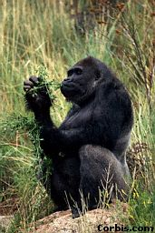


Species tree estimation: difficult, even for small datasets
Orangutan
Gorilla
Chimpanzee
Human
From the Tree of the Life Website,
University of Arizona

Slide 92
Species tree estimation
1- Concatenation: statistically inconsistent (Roch & Steel 2014)
2- Summary methods: can be statistically consistent
3- Co-estimation methods: too slow for large datasets

Slide 93
Is Concatenation Evil?
Joseph Heled:
  YES
John Gatesy
  No
Data needed to held understand existing methods and their limitations
Better methods are needed

Slide 94
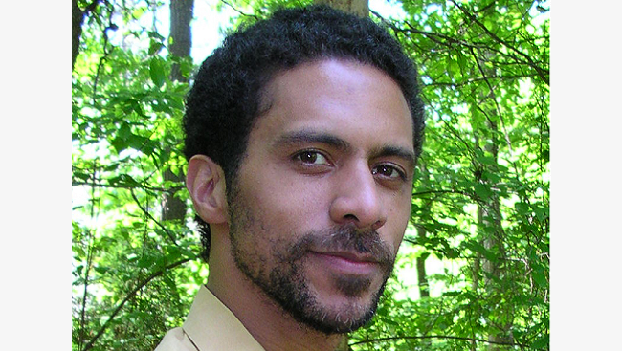


Avian Phylogenomics Project (100+ people)
Erich Jarvis,
HHMI
MTP Gilbert,
Copenhagen
G Zhang,
BGI
T. Warnow
UT-Austin
S. Mirarab Md. S. Bayzid UT-Austin UT-Austin
Approx. 50 species, whole genomes
8000+ genes, UCEs
Gene sequence alignments and trees computed using SATé (Science 2009, Systematic Biology 2012)
Concatenation analysis (multi-million site) using ExaML (new version of
RAxML for very long alignments)
Massive gene tree incongruence suggestive of incomplete lineage sorting -- coalescent-based species tree estimation computed using
“Statistical Binning” (Science, in press)

Slide 95
Our methods
“Statistical Binning” (accepted): uses a statistical method to determine sets of “combinable” gene sequence alignments, improves coalescent-based species tree estimation accuracy when gene trees have poor resolution (used for Avian Phylogenomics Project).
ASTRAL (Bioinformatics 2014): polynomial time statistically consistent method, can run on very large datasets of unrooted gene trees.

Slide 96
Mammalian simulations
Based on a biological mammalian dataset of 37 taxa and 442 genes, published by Song et al., PNAS, 2012.
In simulations, we vary
  Levels of ILS
  Number of genes
  Alignment length to control gene tree estimation error
Compare ASTRAL to
  MP-EST, BUCKy
  Concatenation
  MRP, Greedy
Measure species tree error compared to the known true tree

Slide 97
ASTRAL vs. Concatenation
200 genes, 500bp
Less ILS

Slide 98
Analyses of the Song et al. Mammalian dataset
The placement of Scandentia (Tree Shrew) is controversial.
The ASTRAL analysis agrees with maximum likelihood concatenation analysis of this dataset.

Slide 99
Summary
New multiple sequence alignments with improved accuracy and scalability, as well as high robustness to fragmentary data – SATé used in many studies.
New coalescent-based species tree estimation methods that have better accuracy than current methods, and can analyze large datasets (used in 1KP and Avian Phylogenomics project analyses)
New methods for metagenomic taxon identification and abundance profiling with improved accuracy (will be used in analyses here at Illinois)
Method development inspired by collaboration with biologists, and improves biological analyses.

Slide 100
AA Sequence Alignment Error (13 HomFam datasets)
Homfam: Sievers et al., MSB 2011
10,000 to 46,000 sequences per dataset; 5-14 sequences in each seed alignment
Sequence lengths from 46-364 AA

Slide 101
Alignment Accuracy – Correct columns

Slide 102
Other co-estimation methods
Statistical methods:
BAli-Phy (Redelings and Suchard): Bayesian software to co-estimate alignments and trees under a statistical model of evolution that includes indels. Can scale to about 100 sequences, but takes a very long time.
  http://www.bali-phy.org/
StatAlign: http://statalign.github.io/
Extensions of Parsimony
POY (most well known software)
  http://www.amnh.org/our-research/computational-sciences/research/projects/systematic-biology/poy
BeeTLe (Liu and Warnow, PLoS One 2012)

Slide 103
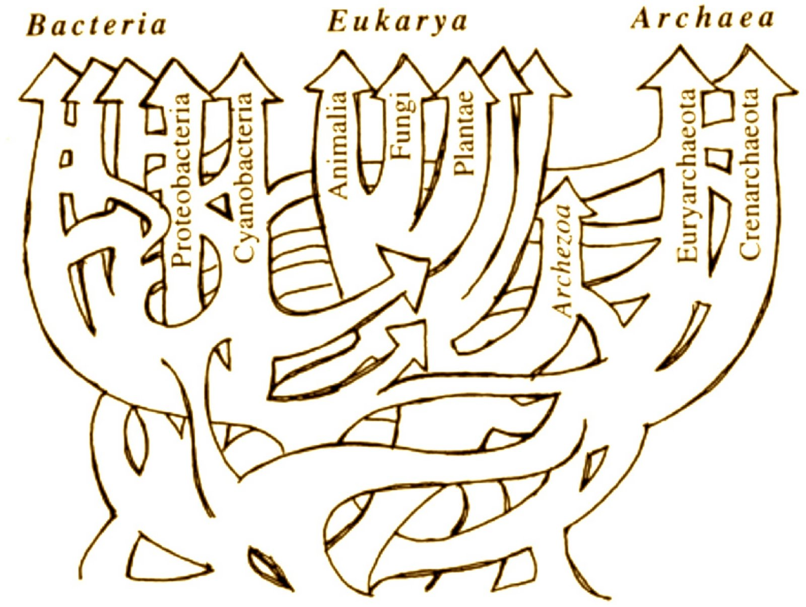
Horizontal Gene Transfer – Phylogenetic Networks
Ford Doolittle

Slide 104
But…
Gene trees may not be identical to species trees:
  Incomplete Lineage Sorting (deep coalescence)
  Gene duplication and loss
  Horizontal gene transfer
This makes combined analysis and standard supertree analyses inappropriate

Slide 105
Two competing approaches
gene 1 gene 2 . . . gene k
Species
. . .
Concatenation
Analyze
separately
. . .
Summary Method
Notes:
point out that supertree methods take overlaping trees and produce a tree, and that the whole process of first generating small trees and then applying a supertree method is often referred to as the “supertree approach”.

Slide 106
How to compute a species tree?
. . .
Notes:
point out that supertree methods take overlaping trees and produce a tree, and that the whole process of first generating small trees and then applying a supertree method is often referred to as the “supertree approach”.

Slide 107
Statistically consistent under ILS?
MP-EST (Liu et al. 2010): maximum likelihood estimation of rooted species tree – YES
BUCKy-pop (Ané and Larget 2010): quartet-based Bayesian species tree estimation –YES
MDC – NO
Greedy – NO
Concatenation under maximum likelihood – NO
MRP (supertree method) – open

Slide 108
The Debate:
Concatenation vs. Coalescent Estimation
In favor of coalescent-based estimation
  Statistical consistency guarantees
  Addresses gene tree incongruence resulting from ILS
  Some evidence that concatenation can be positively misleading
In favor of concatenation
  Reasonable results on data
  High bootstrap support
  Summary methods (that combine gene trees) can have poor support or miss well-established clades entirely
  Some methods (such as *BEAST) are computationally too intensive to use

Slide 109
Results on 11-taxon datasets with strongILS
*BEAST more accurate than summary methods (MP-EST, BUCKy, etc)
CA-ML: (concatenated analysis) also very accurate
Datasets from Chung and Ané, 2011
Bayzid & Warnow, Bioinformatics 2013

Slide 110
Species tree/network estimation
Methods have been developed to estimate species phylogenies (trees or networks!) from gene trees, when gene trees can conflict from each other (e.g., due to ILS, gene duplication and loss, and horizontal gene transfer).
Phylonet (software suite), has effective methods for many optimization problems – including MDC and maximum likelihood.
Tutorial on Wednesday.
Software available at http://bioinfo.cs.rice.edu/phylonet?destination=node/3

Slide 111
Two Basic Questions
1. What is this fragment? (Classify each fragment as well as possible.)
2. What is the taxonomic distribution in the dataset? (Note: helpful to use marker genes.)
Notes:
The two basic steps in phylogenetic placement is similar to the two phase methods we typically use, align and then place the fragment.
The differences are we align each fragment independently into the backbone tree. We then take each extended alignment and place each fragment independently into the backbone tree.
Two methods to align the query sequences are HMMALIGN, which estimates a hidden markov model on backbone alignemnt, then aligns query sequence. PaPaRa, which estimates ancestoral parsimony state vectors for each each in the reference tree and aligns the query sequence against each state vector. It selects the best scoring alignment.
Two methods that place the query sequence try to optimize the same criterion: find the ML placement given the extended alignment

Slide 112
SEPP
SEPP: SATé-enabled Phylogenetic Placement, by Mirarab, Nguyen, and Warnow
Pacific Symposium on Biocomputing, 2012 (special session on the Human Microbiome)
Tutorial on Thursday.

Slide 113
Other problems
Genomic MSA estimation:
  Multiple sequence alignment of very long sequences
  Multiple sequence alignment of sequences that evolve with rearrangement events
Phylogeny estimation under more complex models
  Heterotachy
  Violation of the rates-across-sites assumption
  Rearrangements
Estimating branch support on very large datasets

