Slide 1


Towards Automated Performance Diagnosis in a Large IPTV Network
Ajay Mahimkar, Zihui Ge, Aman Shaikh, Jia Wang, Jennifer Yates, Yin Zhang, Qi Zhao
UT-Austin and AT&T Labs-Research
mahimkar@cs.utexas.edu
ACM Sigcomm 2009

Slide 2
Internet Protocol Television (IPTV)
Television delivered through IP network
  Encoded in series of IP packets
Rapid deployment by telecom companies
  New services: quadruple-play (digital voice, TV, data & wireless)
  More flexibility and interactivity for users
One of the largest commercial IPTV deployments in US
  By 2008, more than 1 million customers spanning 4 time-zones
  Supports advanced features
    Digital video recording (DVR), Video on demand (VoD)
    High definition (HD) channels, Choice programming
Notes:
IPTV encodes live TV streams in a series of IP packets and delivers them to users through residential broadband access networks. There are two key reasons for the rapid deployment of IPTV by telecommunication companies. First, IPTV allows Internet Service Providers (ISPs) to strengthen their competitiveness by offering new services such as quadruple-play combining digital voice, TV, data and wireless. Second, IPTV offers users much more flexibility and interactivity and opens up opportunities for a broad range of new applications.
In this paper, we use IPTV data collected from one of the largest commercial IPTV deployments in North America. As of 2008, it had more than 1 million customers spanning four time-zones. Along with live TV, the service provider also supports advanced features such as digital video recording, video on demand, high definition (HD), and choice programming.

Slide 3
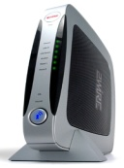
IPTV Service Architecture
SHO
Servers
VHO
IO
Provider Network
CO
DSLAM
RG
STB
Customer
Home Network
PC
Phone
TV
Notes:
No dynamic join or leave
No traffic burst
Talk about key elements = tree like
Multi-hop path
Shown is the architecture of how IPTV service is delivered to residential customers by the service provider. The Super Head-end office (SHO) is the primary source of television content and encodes and transmits video streams to multiple VHOs through a high speed backbone network. The VHOs are responsible for covering a metropolitan area. They acquire additional local contents (such as local news), perform processing (such as ad insertion) and transmit the processed TV streams to the end users upon request.
Depending on the service provider, these TV streams go through a various number of routers and switches such as intermediate offices, central offices and DSLAM before reaching a residential home.
Inside a home, a residential gateway serves as a modem and connects to one or more STBs. It receives and forwards all data including TV, STB control traffic, VoIP and Internet data, into and out of customer home. Each STB connects to a TV.

Slide 4
IPTV Characteristics
Stringent constraints on reliability and performance
  Small packet loss or delay can impair video quality
Scale
  Millions of devices (routers, servers, RG, STB)
  Number is growing
Complexity
  New service
  New application for native IP multicast
    Operational experience with IP multicast is limited
Notes:
IPTV has several unique characteristics.
First, IPTV imposes stringent constraints on both reliability and performance. Even a small amount of packet loss or delay can seriously impair the video quality perceived by users. Second, IPTV networks have tremendous scale. It already has on the order of millions of residential devices and the number is growing. Third, IPTV uses a tree-like topological structure as opposed to mesh. And it heavily relies on IP multicast for distribution of content. Multicast has been available for almost two decades, however, it is starting to have wide-scale deployment and usage only recently. The operational experience with multicast is limited.
These characteristics impose significant challenges in the effective management of IPTV networks and service.

Slide 5
Problem Statement
Characterize faults and performance in IPTV networks
  What are the dominant issues?
  Is there spatial correlation between different events?
  Is there daily pattern of events?
Detect and troubleshoot recurring conditions
  Temporal – repeating over time
    E.g., recurring poor picture quality at TV
  Spatial – re-occurring across different spatial locations
    E.g., software crashes at multiple set-top-boxes within a region
Lots of alarms. How do you identify recurring
conditions of interest to network operators?

Slide 6
IPTV Measurement Data
Customer care call records
  Trouble tickets related to billing, provisioning, service disruption
Home network performance / activities
  User activities: STB power on/off, STB resets, RG reboots
  Performance/Faults: STB software crashes
Provider network performance
  Syslogs at SHO, VHO
  SNMP (CPU, memory, packet counts) at SHO, VHO, IO, CO
  Video quality alarms at monitors

Slide 7
IPTV Characterization
Ticket
Live TV Video
Requested info
DVR
Remote control
Equipment
High definition (HD)
Audio
Program guide
Video on demand (VoD)
Parental Control
Data analyzed over 3 months
Customer Trouble Tickets
  Performance related issues
  Sample Live TV video tickets
    Blue screen on TV
    Picture freezing
    Poor video quality
  Small degree of spatial correlation
Decreasing in
frequency
.
.
.
.

Slide 8
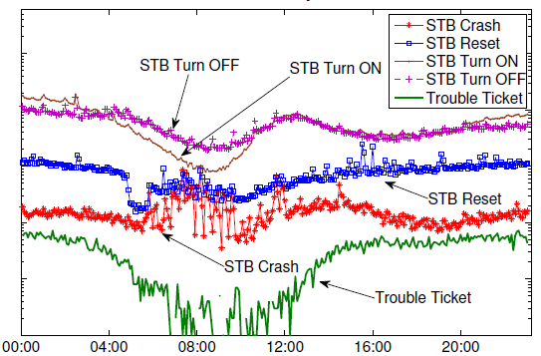
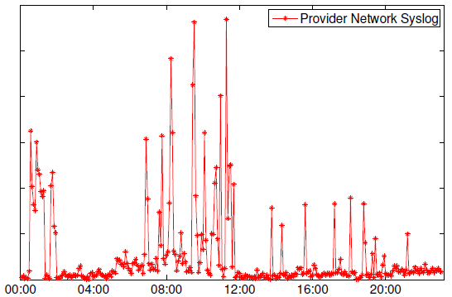
Daily Pattern of Events
Lot of activity between:
00:00 and 04:00 GMT (evening prime time)
12:00 and 23:59 GMT (day time)
Relatively quiet period between
4:00 and 12:00 GMT (customers are sleeping)
Number of syslogs at SHO/VHO is high. (provisioning and maintenance)

Slide 9
Giza
First multi-resolution infrastructure
  Detect and troubleshoot spatial locations that are experiencing serious performance problems
  Detection
    Output locations (e.g. VHO, or STB) that have significant event counts
  Troubleshooting
    Output list the other event-series that are the potential root-causes
Spatial locations
E.g., VHO or Customer network
Symptom
E.g., video quality degradation
Giza
Root-causes for symptom
E.g., STB Crash

Slide 10
Mining Challenges
Massive scale of event-series
  Each device (SHO, VHO, RG) can generate lots of event-series
  Blind mining could easily lead to information snow of results
Skewed event distribution
  Small frequency counts for majority of events
    Insufficient sample size for statistical analysis
  Heavy hitters do not contribute to majority of issues
Imperfect timing information
  Propagation delay: From event location to measurement process
  Distributed events: From root of tree (SHO) towards RG
Notes:
For effective and automated troubleshooting using mining, we need to address several interesting challenges:
Scale – There are on the order of millions of devices from SHO, VHO to residential gateways that result in a tremendous volume of event-series data. Digging through this mound of data for troubleshooting and root-cause diagnosis is a challenging problem.
The majority of individual events have small frequency counts. This makes it challenging for performing statistical analysis due to insufficient sample size. Also, the heavy hitters do not contribute to the majority of issues. Thus, there is a need to perform aggregation of events, both in space (locations) and time.

Slide 11
Giza
(scalability and skewed
event distribution )
Symptom
Hierarchical
Heavy Hitter
Detection
Spatial
locations
(Filter irrelevant events)
Spatial Proximity Model
Unified
Data Model
Statistical Correlation
Other
Network
Events
(Event impact)
(Imperfect timing)
Remove Spurious Edges
Learn Edge
Directionality
Causality Discovery
Root-Causes for Symptom
(Sparsity)

Slide 12
Hierarchical Heavy Hitter Detection
Identify spatial regions where symptom count is significant
  E.g., customers in Texas have poor video quality
Significance test
  Account for (i) event frequency and (ii) density concentration
  Null hypothesis: children are drawn independently and uniformly at random from lower locations
Region
SHO
VHO
Metro
IO
CO
DSLAM
STB / RG
IPTV Pyramid Model

Slide 13
Causal Graph Discovery
First, learn edge directionality
  Idea: use approximate timing to test statistically precedence
    Using lag correlation
    Compute cross-correlations at different time-lags
    Compare range of positive lags with negative lags
  Addresses
    Imperfect timing
    Auto-correlation within each event-series
Second, condense correlation graph
  Idea: identify smallest set of events that best explains symptoms
    Using L1-norm minimization and L1-regularization
  L1-regularization achieves sparse solution
A
B
A statistically precedes B
Notes:
For example, A is fixed and B is circularly shifted
If B is shifted to the left (i.e., negatively shifted) then correlation score will be higher as compared to when B is shifted to the right

Slide 14
Giza Experiments
Validation
  Select customer trouble tickets as input symptom
  Apply Giza to identify potential root causes
  Ground truth: mitigation actions in customer trouble tickets
  Result: Good match between ground truth and Giza output
Case Study: Provider network events
  Identify dependencies with customer trouble tickets
  Result: Giza discovered unknown causal dependency
Causality Discovery Comparison
  Ground truth: networking domain knowledge
  Result: Giza performs better than WISE (Sigcomm’08)
Majority of tickets explained by home network issues

Slide 15
Case Study: Provider Network Events
VRRP Packet
Discards
VRRP Packet
Discards
Multicast (PIM)
Neighbor Loss
Multicast (PIM)
Neighbor Loss
Shadow edges are
spurious correlations
OSPF Interface
State Down
Layer-1 Alarms
Link Down
SDP Bind
State Changes
Configuration
Changes
MPLS Path
Re-routes
MPLS Interface
State Changes
SAP Port
State Changes
Dependency between VRRP packet discards and PIM timeouts was unknown
Behavior more prevalent within SHO and VHOs near SHO
We are investigating with operations team

Slide 16
Comparison to Related Literature
 | Sherlock Kandula et al. Sigcomm’07 | WISE Tariq et al. Sigcomm’08 | Orion Chen et al. OSDI’08 | NICE Mahimkar et al. CoNEXT’08 | NetMedic Kandula et al. Sigcomm’09 | Giza Mahimkar et al. Sigcomm’09
Original Focus | Enterprise Networks | Content Distribution Networks | Enterprise Networks | ISP Backbone Networks | Enterprise Networks | IPTV Networks
Eliminate spurious dependencies |  | YES |  |  |  | YES
Achieve sparse solution |  |  |  |  |  | YES
Automated edge directionality | YES | YES | YES |  | YES | YES
Multi-resolution analysis |  |  |  |  |  | YES

Slide 17
Conclusions
First characterization study in operational IPTV networks
  Home networks contribute to majority of performance issues
Giza - Multi-resolution troubleshooting infrastructure
  Hierarchical Heavy Hitter detection to identify regions
  Statistical correlation to filter irrelevant events
  Lag correlation to identify dependency directionality
  L1-norm minimization to identify best explainable root-causes
Validation and case studies demonstrate effectiveness
Future Work
  Troubleshooting home networks
  Network-wide change detection

Slide 18
Thank You !

